Slide 1

OPEN DATA PRACTICES FOR
BUSINESS AND CITY
Sweden

Slide 2




What is OPEN DATA?
”Open data” is data that anyone can access, use and share. Governments, businesses, and individuals can use open data to bring about social, economic, and environmental benefits

Slide 3
Why do we need OPEN DATA?
Transforming governments so they are more transparent against corruption.
Open data opens up new opportunities for businesses to connect with customers.
Protecting our planet, with open data about weather.
Public Service improvement
Efficiency
Innovation and Economic Value

Slide 4
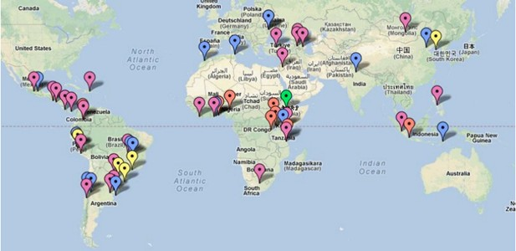
OPEN DATA: Global Phenomenon

Slide 5
Some Open Data Facts
Swedish Open Data portal :
https://www.dataportal.se/en/
Sweden was the first country in the world to enact a law guaranteeing
public right to information (1776).
Sweden was named the fourth most transparent country by the Corruption Perceptions Index.

Slide 6
Open Data practices: Example
for the business
UC
service
Quick Facts
Company: UC
Sector: Finance & Inshurance
Product/Service: Service
Type of data: All domains
Origin: Sweden
URL https://www.uc.se/en
Benefits
Collects Data
Gives information on market`s credit reference
Analyze this data
Allows checking customer`s creditworthiness and ability to pay
Accurate data allows doing more business, by granting credit or creditworthy customers and requesting advance payment or other payment terms for customers carrying a high risk.
How Open Data is used
Service to provide companies with credit information
Collects credit data from over 10 different sources(Tax Agency, Companies Registration Office…)
Analysis of the credit information(for example key ratios for different industries and company sizes.

Slide 7
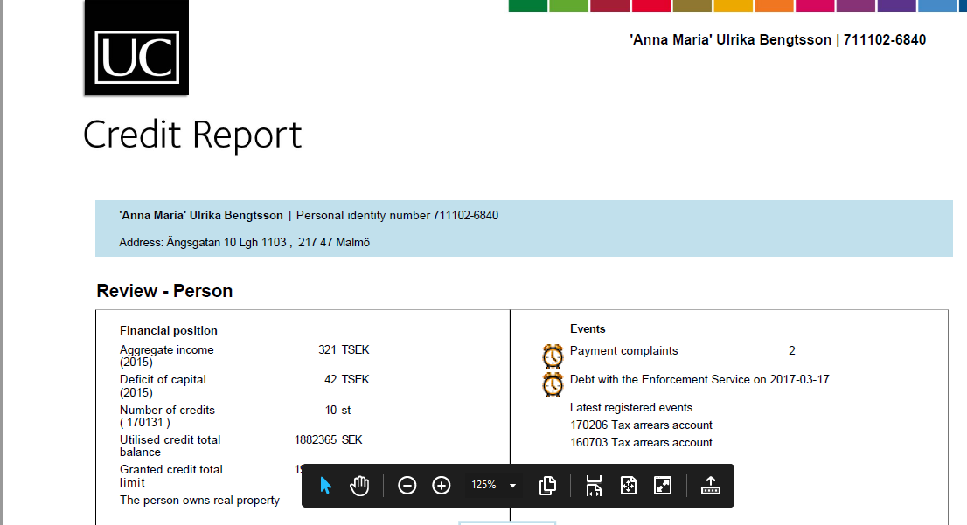
How UC service function?
When a company(usually a financial company) requests a Customer Report from UC service
UC provides a comprehensive credit report containing :
Details of income 2 years back in time
Credit commitments
Property holdings
Remarks
Historical Remarks
Debt balances
Credit Report Sample

Slide 8
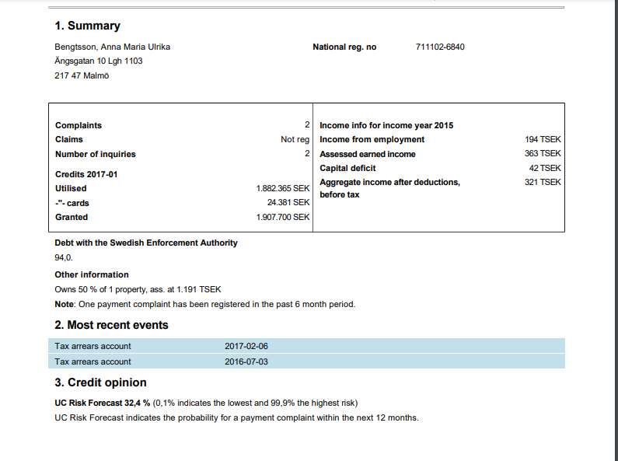
How UC service function?
Credit Report Sample

Slide 9
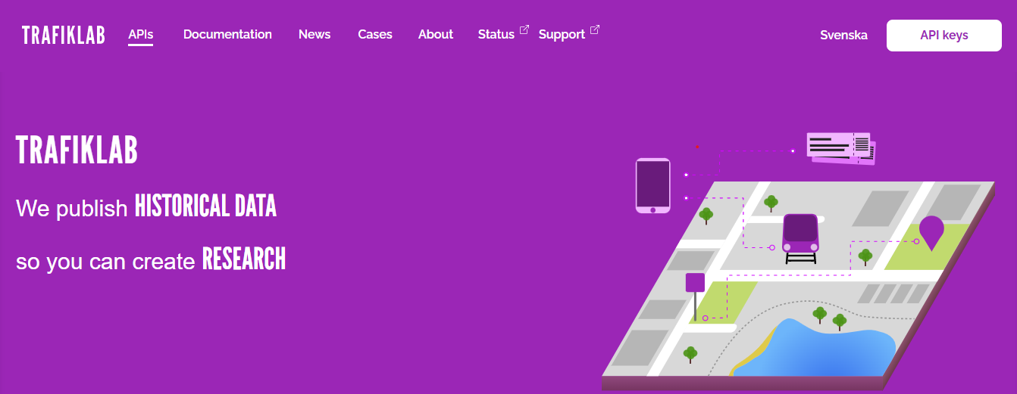
Open Data practice: Example1 for the
city
TRAFIKLAB
Web site
Quick Facts
Company: TRAFIKLAB
Sector: Public Transport
Product/Service: Web site
Type of data: Transportation/Traffic
Origin: Sweden
URL https://www.trafiklab.se/
Benefits
Developers can access data and APIs
Information is needed to develop smart services that benefit travelers and society
It benefits open data-based innovation in the mobility sector
How Open Data is used
The documentation is divided into two parts:
API documentation: a description of all APIs and their details
General documentation: describing how to best use Trafiklab, APIs, and traffic data.
Contains public data and data
from the transport sector on the same platform.

Slide 10
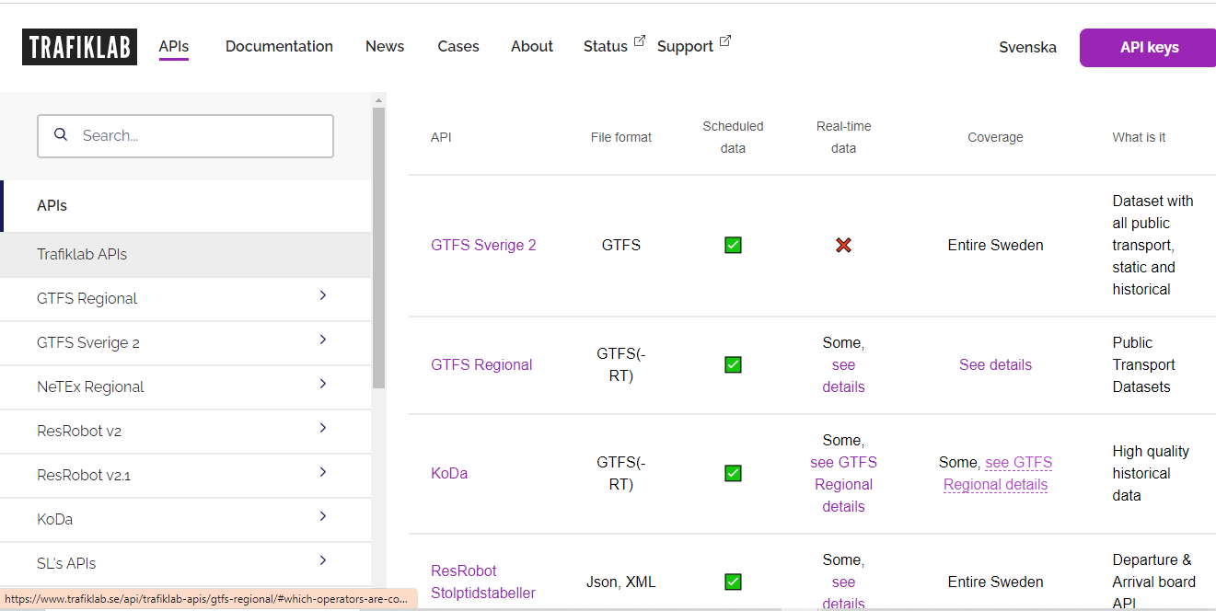
How TRAFIKLAB function?
Trafiklab APIs
Trafiklab is offering a wide range of APIs and datasets.
Each API and dataset provides data of a different kind of format.
The following page is giving us an overview of all the data, describing what’s included, the format, how to get it, and some examples.

Slide 11
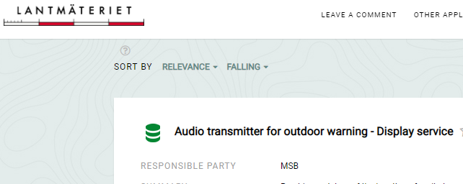
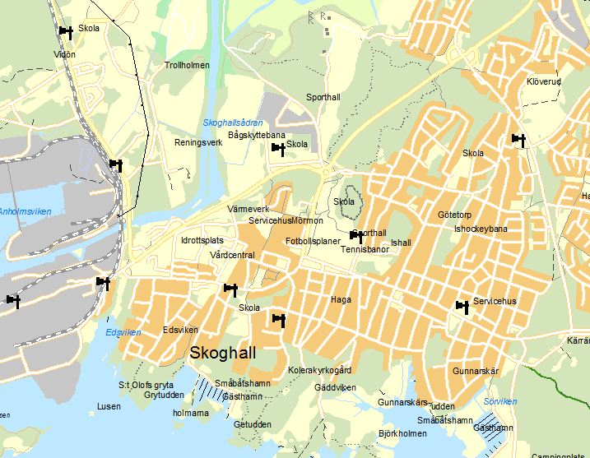
Open Data practices: Example2 for city environment
Audio transmitter
for outdoor warning.
Provides a picture of the location of audio transmitters in the municipalities.
This data it is used to see how well the inhabitants of the municipalities can be reached via outdoor warning in the event of a serious accident, and provide instructions if an expansion of the system would be needed to cover newly built areas or new risk areas, with regard to the municipalities' risk and vulnerability analysis.
Lantmäteriet data portal
provides a number of map products and other geographic information such as open spatial data. These products are free of charge and may be used and published freely.

